Slide 1
Introduction to Computers

Slide 2
In this chapter, we introduce you to the concepts of computer science,
especially as they pertain to computer programming.

Slide 3
Objectives
  To review basic computer systems concepts
  To be able to understand the different computing environments and their components
  To review the history of computer languages
  To be able to list and describe the classifications of computer languages
  To understand the steps in the development of a computer program
  To review the system development life cycle

Slide 4
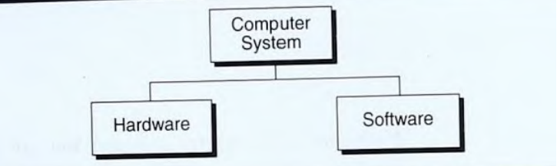
Computer Systems
  Today computer systems are ubiquitous (found everywhere).
  A computer is a system made of two major components hardware and software.

Slide 5
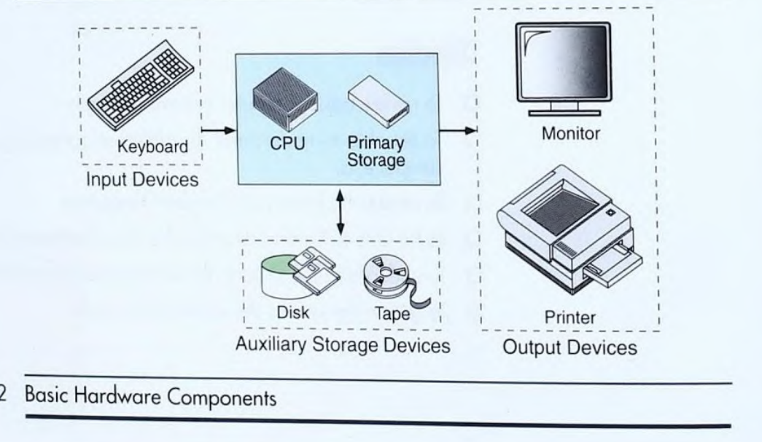
Computer Systems

Slide 6
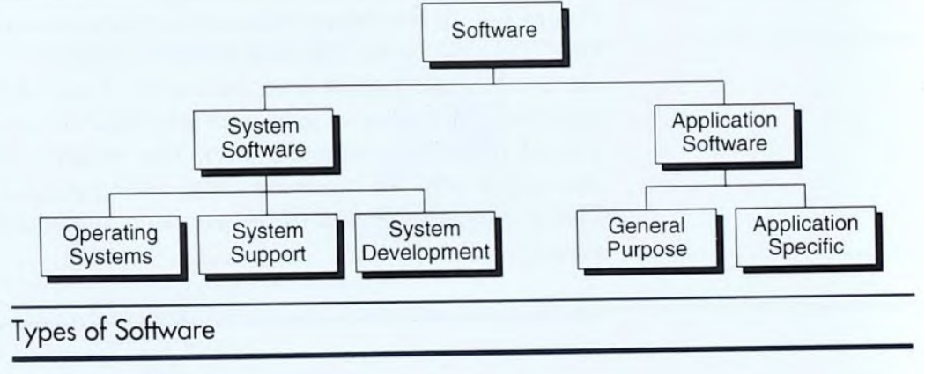
Computer Systems

Slide 7
Computing Environments
  Personal Computing Environment: All of the computer hardware components are tied together in our personal computer (PC).
  Time-Sharing Environment: Many users are connected to one or more computers. E.g. employees sharing a printer.
  Client/Server Environment: A client/server computing environment splits the computing function between a central computer and users’ computers.
  Distributed Computing: A distributed computing environment provides a seamless integration of computing functions between different servers and clients. E.g. Internet.

Slide 8
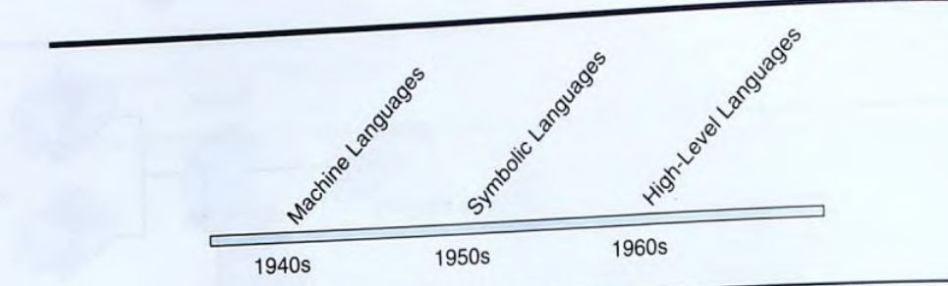
Computer Languages
  To write a program for a computer, we must use a computer language.
  Over the years computer languages have evolved from machine languages to natural languages.

Slide 9
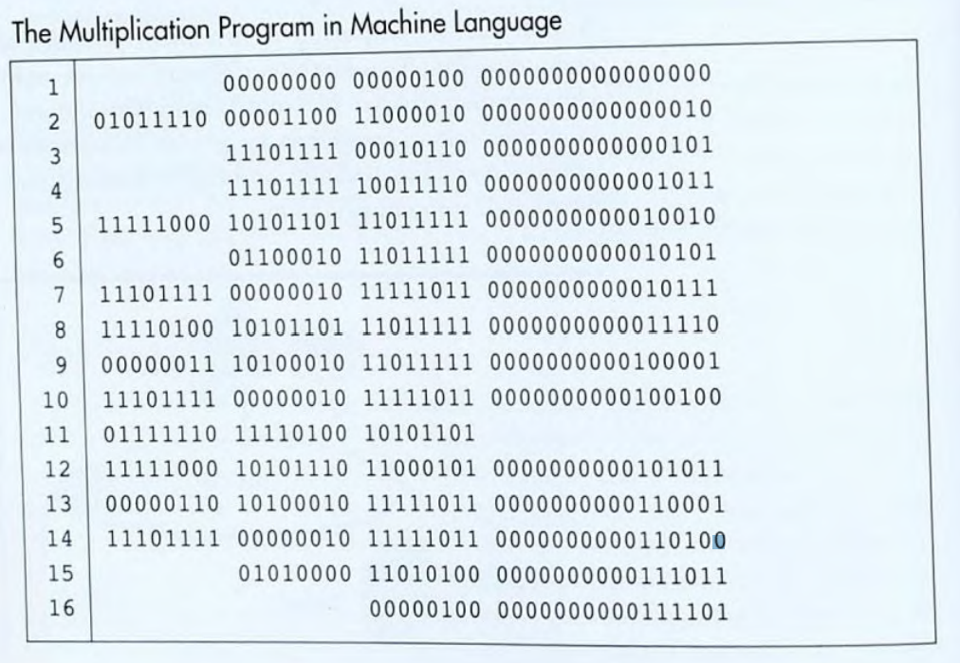
Machine Languages
  Each computer has its own machine language, which is made of streams of 0s and 1s.
  The OFF state is represented by 0; the ON state is represented by 1.

Slide 10
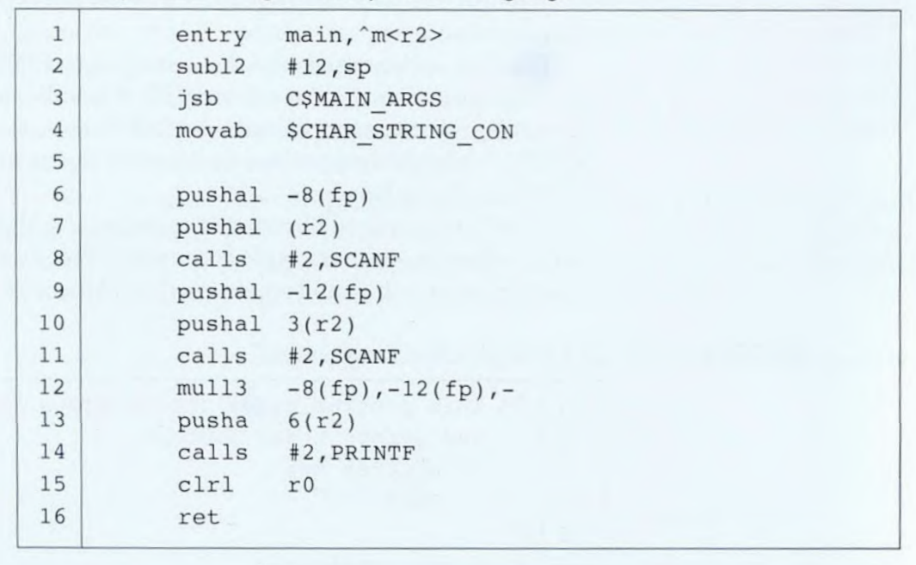
Symbolic Languages
  A few programs would be written with machine language.
  Symbols, or mnemonics, to represent the various machine language instructions.
  Because a computer does not understand symbolic language, it must be translated to the machine language.
  A special program called an assembler translates symbolic code into machine language, thus assembly languages.

Slide 11
High-Level Languages
  Although symbolic languages greatly improved programming efficiency, they still required programmers to concentrate on the hardware that they were using.
  Working with symbolic languages was also very tedious because each machine instruction had to be individually coded.
  High-level languages are portable to many different computers, allowing the programmer to concentrate on the application problem at hand rather than the intricacies of the computer.
  High-level languages must be converted to machine language in a process called compilation.

Slide 12
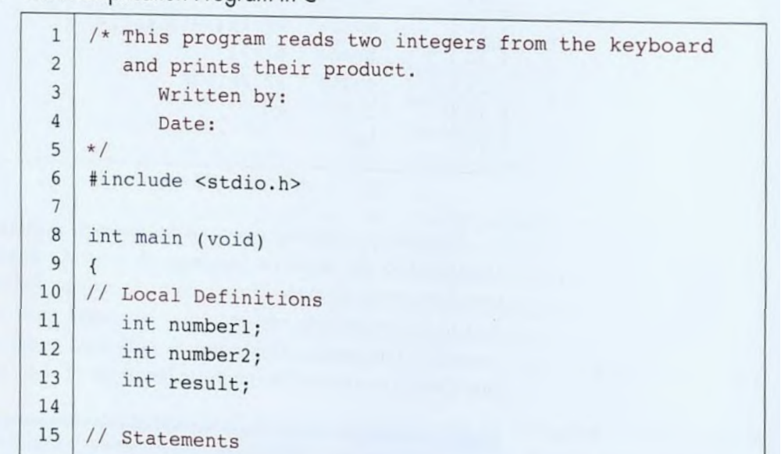
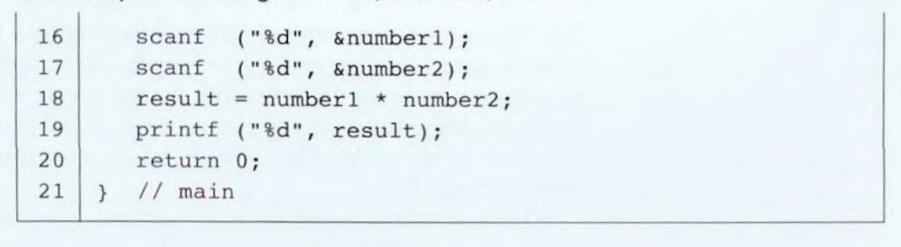
High-Level Languages Cont.
  High level languages included-FORTRAN, COBOL, etc.
  C, with its standard libraries, is considered a high-level language used for system software and new application code.

Slide 13
Creating and Running Programs

Slide 14
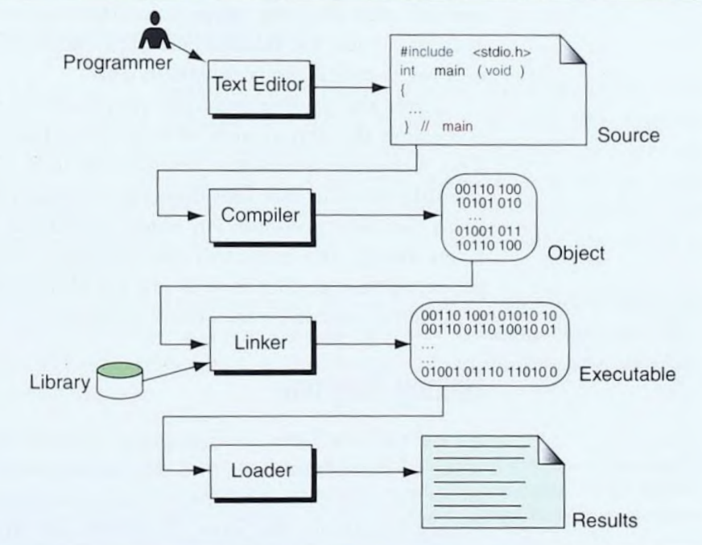
  A computer hardware understands a program only if it is coded in its machine language.
  It is the job of the programmer to write and test the program. There are four steps in this process:
      Writing and editing the program.
      Compiling the program.
      Linking the program with the required library modules.
      Executing the program.
Building a C Program

Slide 15
Writing and Editing Programs
  Text editors are used to write programs.
  Programs are written using lines of code.
  Some of the features you should look for in your editor are search commands, copy and paste commands, and formatting commands.
  After we complete a program, we save our file to disk. This file will be input to the compiler; it is known as a source file.

Slide 16
Compiling Programs
  The code in a source file stored on the disk must be translated into machine language by a compiler.
  The C compiler is actually two separate programs: the preprocessor and the translator.
  The preprocessor reads the source code and prepares it for the translator.
  After the preprocessor has prepared the code for compilation, the translator does the actual work of converting the program into machine language.
  The translator reads the translation unit and writes the resulting object module to a final program.
  An object module is the code in machine language.

Slide 17
Linking Programs
  Later, we will see that a C program has many functions.
  There are other functions such as input/output processes and mathematical library functions that exists elsewhere and must be attached to our program.
  The linker assembles all of these functions, ours, and the system’s into our final executable program.

Slide 18
Executing Programs
  Once our program has been linked, it is ready for execution.
  To execute a program, we use an operating system command, such as run, to load the program into primary memory and execute it.
  Getting the program into memory is the function of an operating system program known as the loader.
  Loader locates the executable program and reads it into memory. When everything is loaded, the program takes control and it begins execution.
  In a typical program execution, the program reads data for processing, either from the user or from a file. After the program processes the data, it prepares the output.
  When the program has finished its job, it tells the operating system, which then removes the program from memory.

Slide 19
System Development
  -In this section, we discuss how we go about developing a program.
  -This critical process determines the overall quality and success of our program.
  -If we carefully design each program using good structured development techniques, our programs will be efficient, error-free, and easy to maintain.

Slide 20
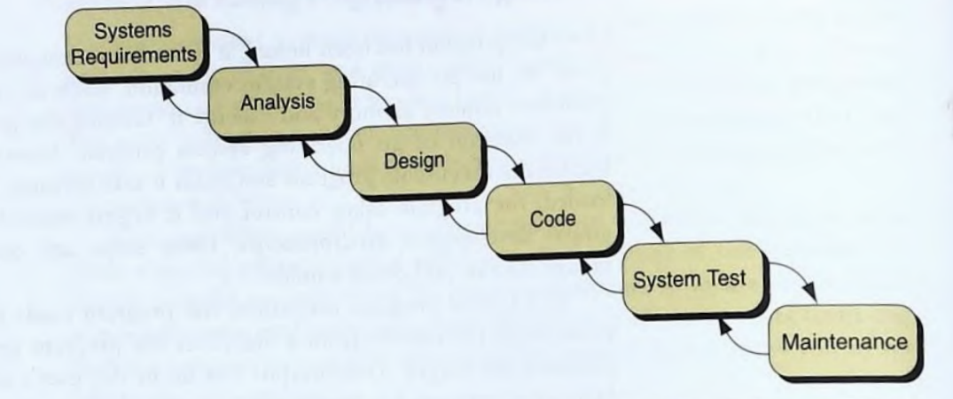
System Development Life Cycle
  Today’s large-scale, modern programming projects are built using a series of interrelated phases commonly referred to as the system development life cycle.
  Waterfall model is most commonly used. This model consists of between five and seven phases.

Slide 21
System Development Life Cycle
  System Requirement: The systems analyst defines requirements that specify what the proposed system is to accomplish.
  Analysis: Looks at different alternatives from a system’s point of view
  Design: Determines how the system will be built
  Code: How we write program (interest of this Unit)
  System test: programs are tested together to make sure the system works as a whole.
  Maintenance: Keeps the system working once it has been put into production.

Slide 22
Program Development
  A multistep process that requires that we under- stand the problem, develop a solution, write the program, and then test it.
  Program design-Our job is to determine how to take the inputs we are given and convert them into the outputs that have been specified
To give us an idea of how
this process works, let’s look at a simple problem: Calculate the square footage of a house. How do we go about doing this?

Slide 23
Program Development
  Step 1: Understand the problem- ask several questions such as: What is the definition of square footage.
  Step 2: Developing the solution- We can use tools such as
      Structure Charts- used to design the whole program
      Pseudocode, and flowcharts- used to design the individual parts of the program
  Step 3: Write the Program

Slide 24
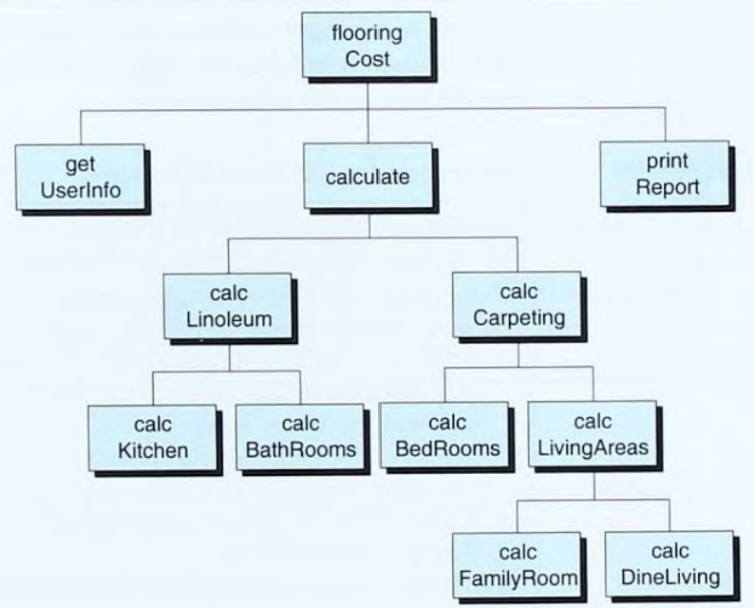
Program Development
  Structure Charts
    Also known as hierarchy chart shows the functional flow throughout the program.

Slide 25
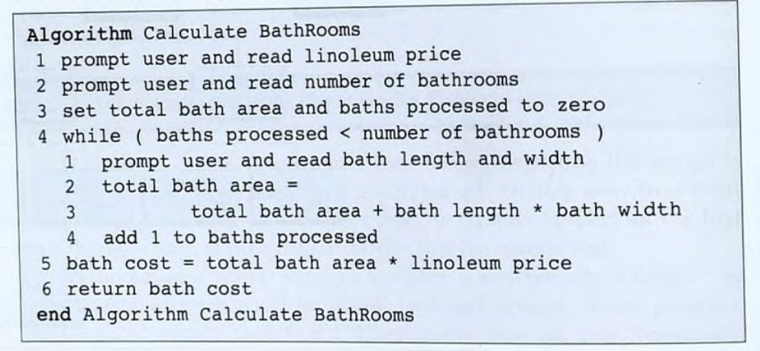
Program Development
  Pseudocode
    Pseudocode is part English, part program logic. Its purpose is to describe, in precise algorithmic detail, what the program being designed is to do.
    Def: English-like statements that follow a loosely defined syntax and are used to convey the design of an algorithm.

Slide 26
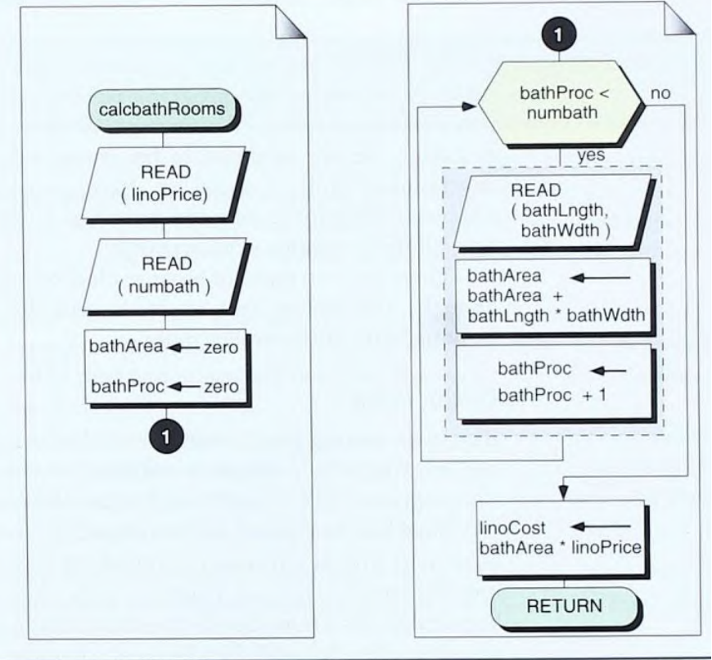
Program Development
  Flowchart
    A flowchart is a program design tool in which standard graphical symbols are used to represent the logical flow of data through a function.

Slide 27
Program Development
  Testing the Program
    Programs are tested for different purposes.
      Blackbox Testing: testing the program without knowing what is inside it. Developed by looking only at the requirements statement
      Whitebox Testing: Assumes that the tester knows everything about the program. In this case, the program is like a glass house in which everything is visible.
        Whitebox testing is our responsibility. As the programmer.

Slide 28
Software Engineering
    Software engineering is the establishment and use of sound engineering methods and principles to obtain software that is reliable and that works on real machines.

